Slide 1
REDCap and R
Stephan Kadauke MD PhD

Slide 2
Goal: Learn how to download and process REDCap data using R
Objectives:
Download data from a REDCap database into R using REDCapR or REDCapTidieR
Drill down into the REDCapTidieR supertibble using the RStudio Data Viewer
Use REDCapTidieR utility functions to extract individual data tibbles, apply labels, and export to Excel

Slide 3

What is REDCap?
Database solution for research and operations
Secure and accessible from a web browser
Can collect “any type of data in any environment”
Probably installed at your institution, you can probably use it for free, and you can probably even store PHI
https://www.project-redcap.org

Slide 4

What is REDCapR?
An R package for interacting with REDCap
A set of functions that wrap the REDCap API
redcap_read()
redcap_metadata_read()
redcap_write()
Well engineered, tested, and maintained
https://ouhscbbmc.github.io/REDCapR

Slide 5


The REDCART database
Simulated dataset on patients treated with chimeric antigen receptor (CAR) T cells for B-ALL
Longitudinal – case report forms (CRFs) organized by events
Contains repeated CRFs

Slide 6

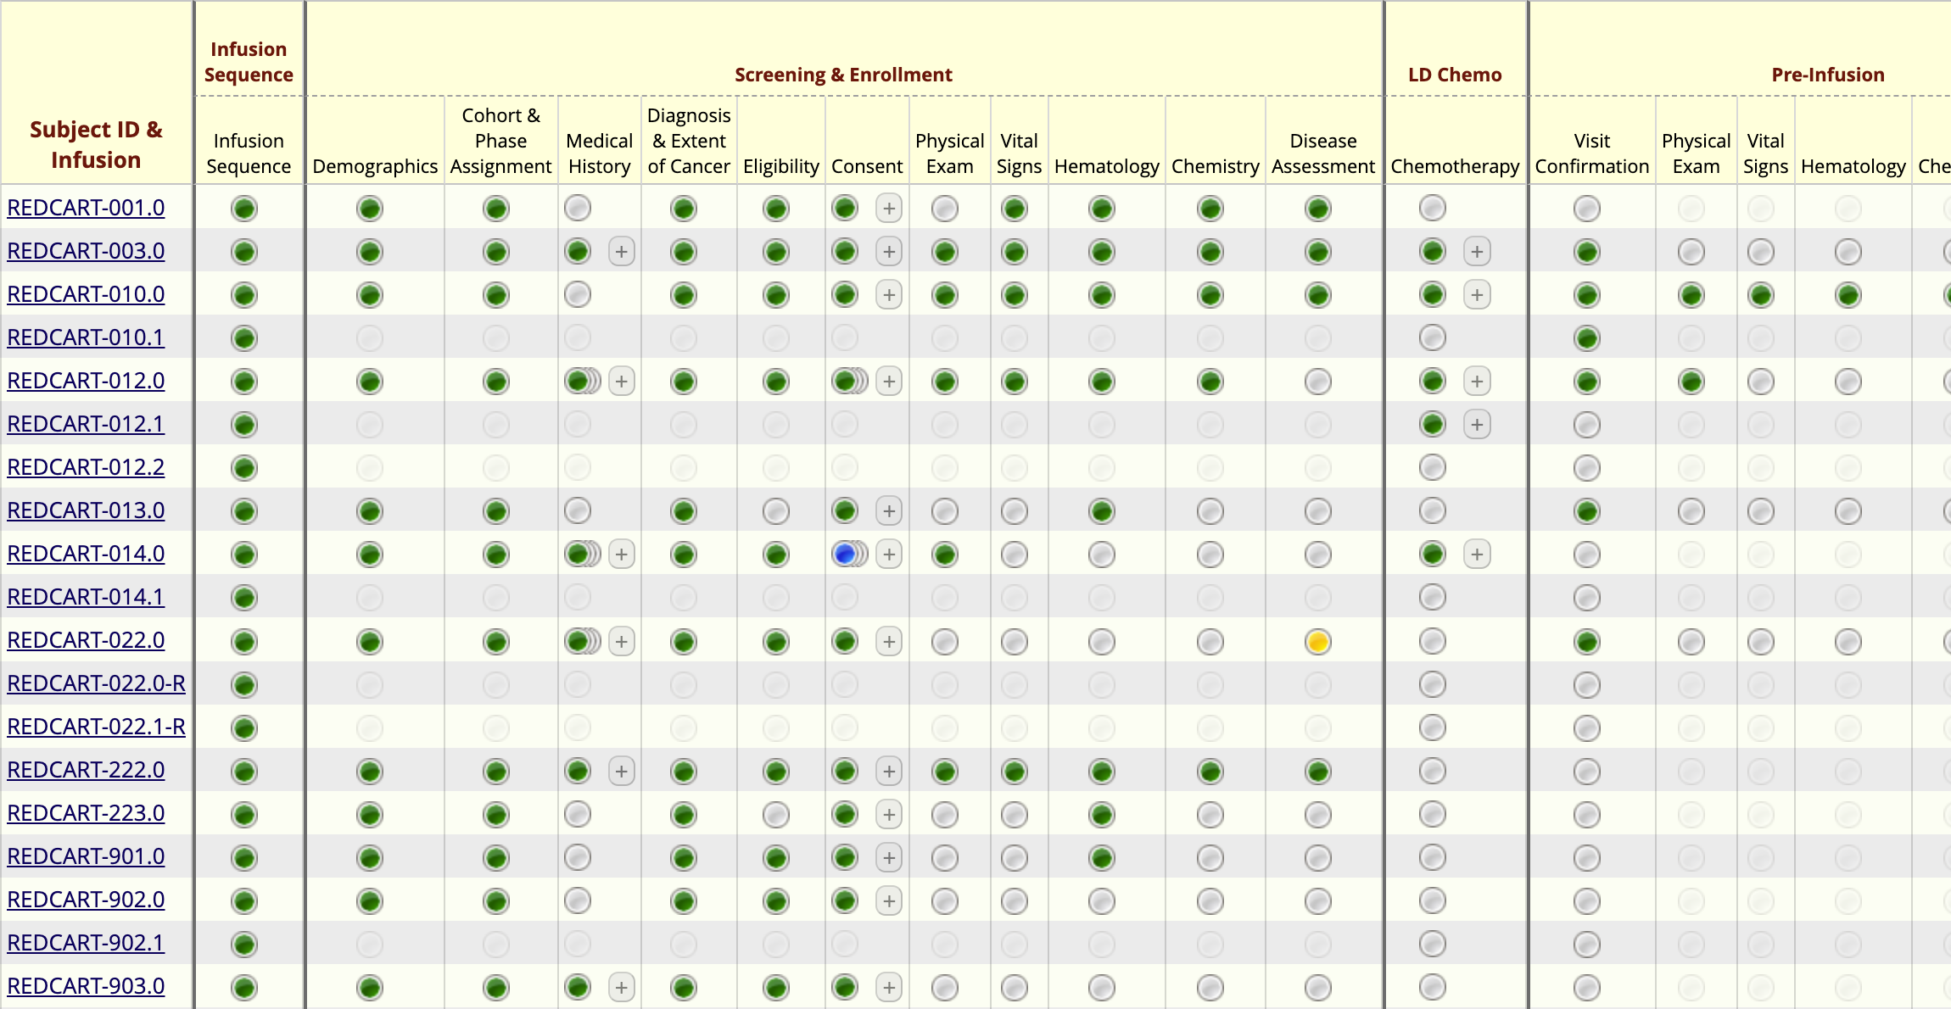
Notes:
Exploring the REDCap-based electronic data capture (EDC) further:
We chose REDCap for several reasons. It's available at CHOP, it's free to use, it's secure for storing sensitive information, and we have complete control over data entry instruments configuration and data handling.
The database, as shown in this screenshot, is longitudinal. It allows us to document repeat measures, such as repeated labs, once for each visit. In addition, we capture adverse events. Adverse events don’t fit neatly into the longitudinal paradigm, but REDCap lets us manage them using a repeated instrument setup.
*** Events
*** Repeated instruments

Slide 7

Your Turn
Open the file named 04 – REDCap and R.qmd In the exercises folder.
Follow the instructions of the section titled Downloading data with REDCapR.
Stop where it says “Stop here”.

Slide 8
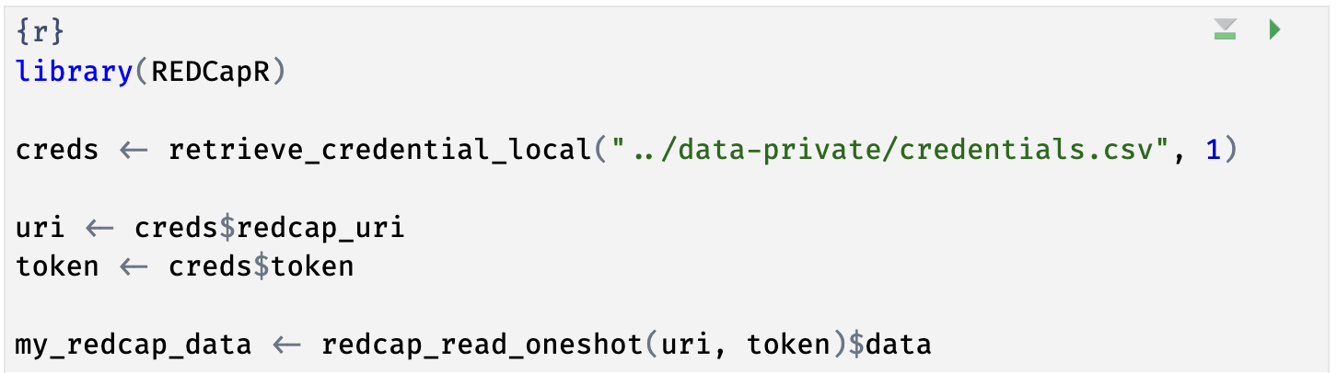
Notes:
Here’s the code chunk you just ran. This code looked up credentials to a REDCap project in a local file, and then downloaded the data from that REDCap project via the REDCap API, facilitated by the REDCapR package. If you haven’t looked at R code before, this will look very strange. In the next few slides I’m going to demystify this code.

Slide 9
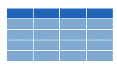


retrieve_credential_local()
creds <- retrieve_credential_local(file_name, pid)
csv
file_name.csv
REDCap PID
Notes:
Let’s look at the next line of code in that chunk. It reads, …
There is a lot of R going on in this line of code. What is does is that first calls a function named retrieve_credential_local(). This function is part of the REDCapR package. It looks at a special CSV file with REDCap credentials, such as an API token and project IDs, and this function returns some information with these REDCap credentials. This information is then stored as an object named creds in R’s memory.
Why do we use that function for this? Because this way we don’t have to hardcode credentials into our R code, which is considered bad practice. So REDCapR makes it easy for you to do the right thing!

Slide 10
object
(stores output)
function
(does stuff)
arguments
(inputs)
creds <- retrieve_credential_local(file_name, pid)
assignment operator
(“gets”)
Notes:
Let’s look a little bit closer at what happens here. First, we have retrieve_credential_local, which is a function. Functions are super important in R.
Functions take zero, one, or more inputs, and they return one output.
** The inputs are called arguments and go into parentheses. If there’s more than one argument, they get separated with commas.
** You can capture the output in an object,
** using the assignment operator. This is a smaller than sign followed by a minus or dash and is supposed to look like an arrow pointing left. In other languages this assignment operator is a single equals sign, and one of the quirks of R is that they use this arrow looking sort of assignment operator instead. People pronounce this operator as “gets” … as in creds ”gets” retrieve_credential_local “of” filename and pid.

Slide 11
uri <- creds$redcap_uri
list
creds
redcap_uri | "https://redcap.chop.edu/api/"
username | "myusername"
project_id | 1
token | "37BCFC38D45F10C47EAF4D8B97BFC32F"
comment | CAR-T cell trials
uri
"https://redcap.chop.edu/api/"
Notes:
Let’s look at the next line. This says, uri <- creds $ redcap_uri
The creds object which we just made in the previous command is a *list*. A list is an object that contains other objects. In this case, “creds” contains the following elements: redcap_uri, username, project_id, token, and comment.
The $ operator extracts an element from a list. In this case we’re extracting the redcap_uri element and then we’re storing it as an object named ‘uri’.

Slide 12
dollar operator
extracts an element from a list
uri <- creds$redcap_uri
list
a type of object that can contain
multiple arbitrary objects
Notes:
…

Slide 13
Your Turn
Write the R code to extract the element named token from the creds object and store it in a new object named token.

Slide 14
token <- creds$token
Notes:
…

Slide 15
Notes:
We actually just went through the first four lines of this code chunk! Let’s look at the last line.

Slide 16
my_redcap_data <- redcap_read_oneshot(uri, token)$data
data frame (tibble)
list
... | ...
data
Notes:
This line reads, …
So we’re calling the redcap_read_oneshot() function from the REDCapR package, giving it the URI and token as inputs. But then there’s this $data thing at the end. What does that mean?
To understand this you have to first realize that the output of redcap_read_oneshot is a list. That list has a bunch of information about the REDCap database, but importantly, it has an element named “data” which contains the data from the REDCap project. We can use the function call as if we already knew that we’ll be getting back a list, and then use $data to just extract that data, and discarding all the other information of the list.
Then we use the assignment operator to store the data in an object named my_redcap_data.
** So again, the redcap_read_oneshot() function takes the URI and API token as inputs and returns a list, that contains a ”data” element.
** This data element contains a type of object that’s called a data frame or tibble. This is similar to an Excel sheet in that it has rows and columns.
** So we’re only extracting that data frame and assigning it to an object named my_redcap_data.

Slide 17
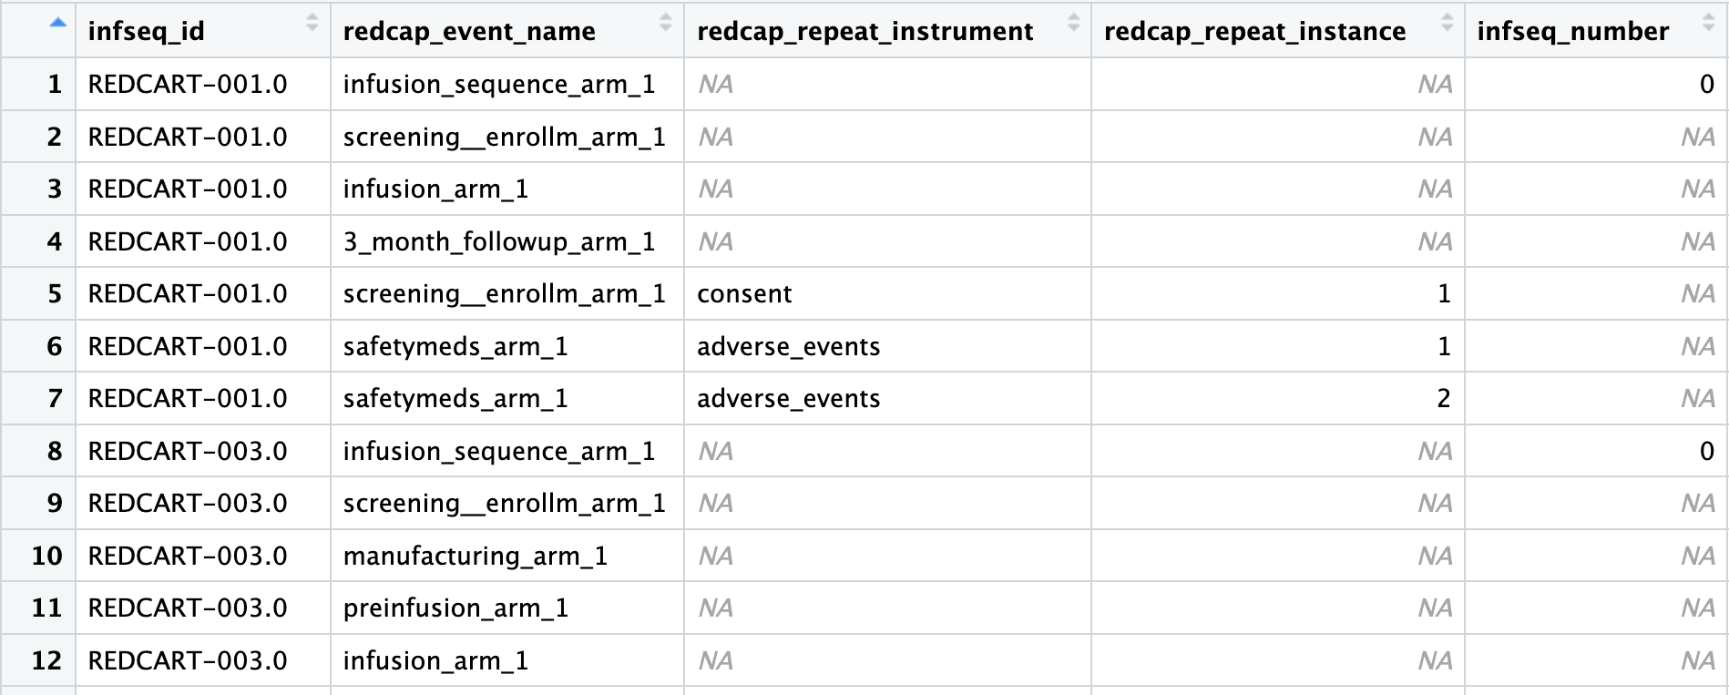
The Problem with Complex REDCap Databases
Notes:
REDCap API mushes everything into one table/data frame. OK for simple databases especially with one CRF only, but problematic if you have lots of instruments, events, and some instruments repeating and some non-repeating
Need to write lots of custom logic to extract the data you’re interested in.

Slide 18

REDCapTidieR
Makes it easy to import any REDCap project into R
Even if complex: longitudinal, repeated events or instruments, surveys, and/or data access groups (DAGs)
Based on REDCapR, makes its output tidier, which makes your work easier.
Is robust and efficient
Follows tidyverse software development lifecycle recommendations
97% test coverage
Extensive error checking with helpful error messages
Profiled and replaced tidyverse code with base R where we found bottlenecks
Notes:
…

Slide 19
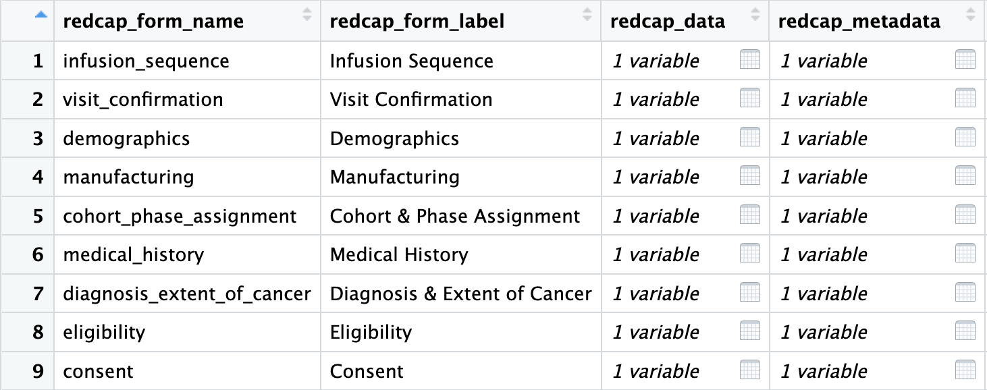
The REDCapTidieR Supertibble
Use read_redcap() to import a REDCap project into R
Returns a supertibble which contains data and metadata broken down by instrument
Notes:
The main function of REDCapTidieR is the read_redcap() function. This function takes a REDCap project’s URI and API key, and it returns a special object that we call the supertibble. The supertibble is a data frame or tibble that represents the whole REDCap project and contains nested tibbles that represent individual REDCap instruments. You get all the data and metadata in one place.
Here, you can see part of the supertibble from a CAR-T trial. Each row of the supertibble represents an instrument. You can see the name and label of the instrument. And then you have the `redcap_data` column that has all of these little table icons. By clicking on one of the table icons, you can drill down into individual data and metadata tibbles. This makes initial data exploration really easy.

Slide 20
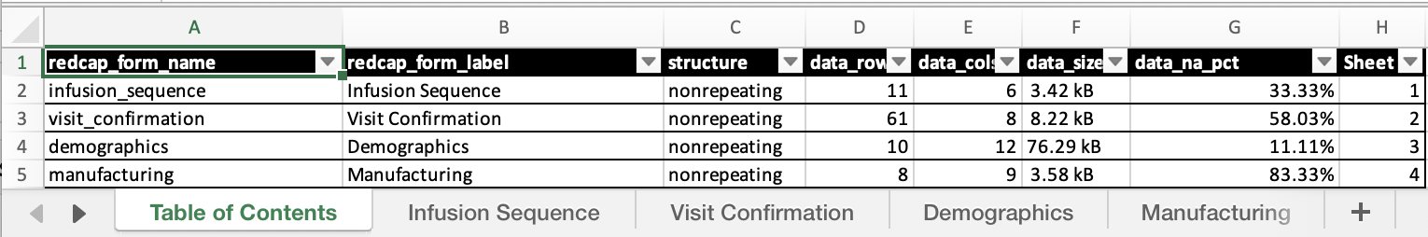
What can I do with the Supertibble?
Use bind_tibbles() or extract_tibble() to extract data from individual instruments
Use make_labelled() to add variable labels
Uses {labelled} to attach REDCap field labels to data columns
Use write_redcap_xlsx() to export to Excel
Collaborator-friendly! Supports labels
Notes:
So, what can you do with the Supertibble?
- You can extract data frames for individual instruments using either the bind_tibbles() or extract_tibble() function. Bind_tibbles() makes the data tibbles magically appear in the Environment, which is useful if you just want to get the REDCap data into R in the easiest possible way. Extract_tibble() extracts and returns an individual data tibble.
*** You can use make_labelled() to add variable labels. Adding human readable labels to cryptic variable names makes data exploration easier. The labels from from the Field Labels in the data entry forms.
*** And you can use write_redcap_xlsx() to export an entire REDCap project to Excel, which one tab per instrument. This is much nicer than the default REDCap export and is really handy for collaborating, and it supports labels so your collaborator can see the descriptions for each variable.

Slide 21
Your Turn
Open the file named 04 – REDCap and R.qmd In the exercises folder.
Follow the remaining instructions, starting from the section titled Extracting Data from REDCap using REDCapTidieR.

Slide 22
Recap
REDCapR provides functions to interact with the REDCap API.
REDCapTidieR makes it easy to work with complex projects that contain longitudinal structure or repeated instruments into R.
The REDCapTidieR supertibble is a special data structure that represents a REDCap project. You can drill down into individual instruments.
Notes:
To recap what we covered up to this point, …

Slide 23
What else?

Slide 24
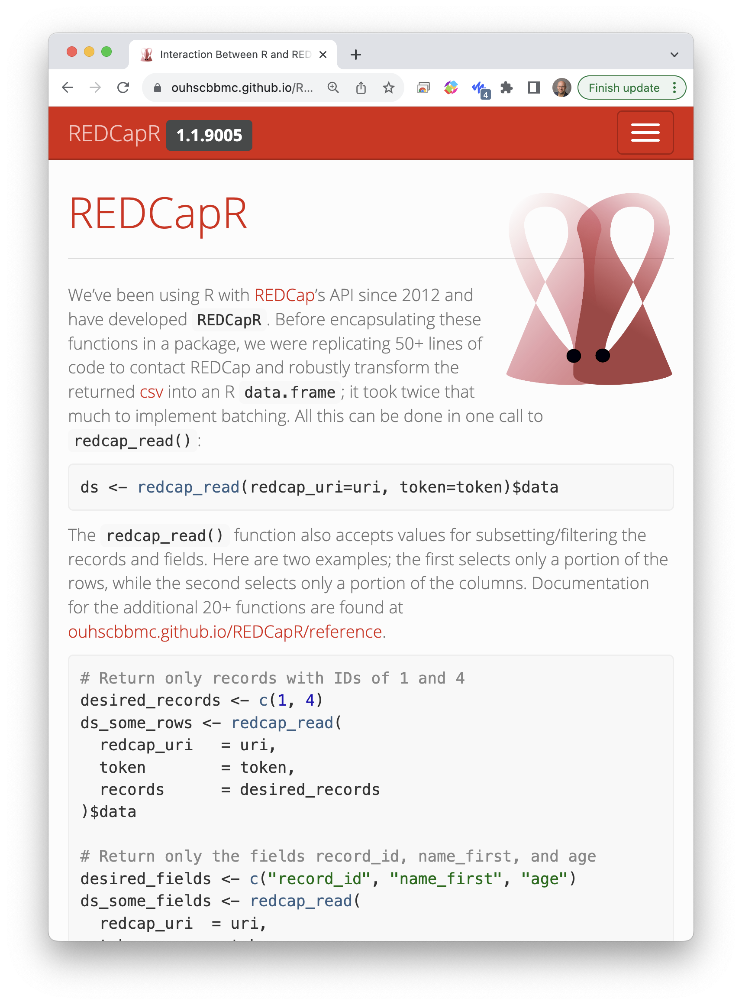
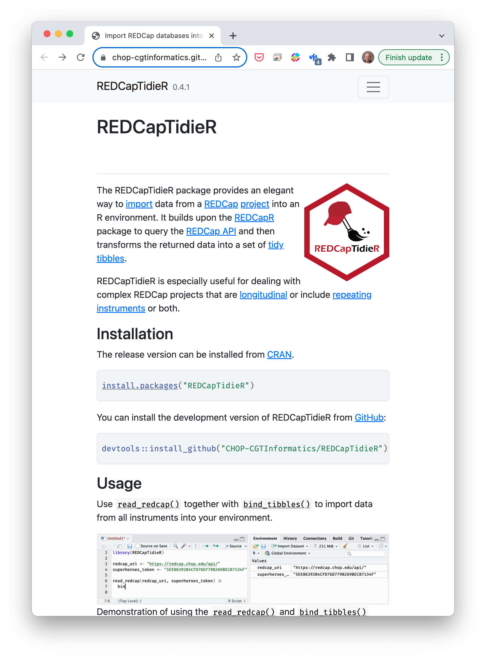
Notes:
Both the REDCapR and REDCapTidieR packages have extensive online documentation, including Getting Started tutorials and deeper dives into common workflows.

Slide 25




Notes:
There are a few additional packages for interacting with REDCap.
tidyREDCap makes it easy to create tables for choose-all or choose-one type questions. REDCapDM provides functions for REDCap database admins. Both of these are built on top of REDCapR.
redcapAPI is Vanderbilt’s package for interacting with the REDCap API, and so it’s an alternative for REDCapR.
REDCapExporter turns REDCap databases into R packages.

